Slide 1
Assignment 3
Min-Wei,Li

Slide 2
Data 1

Slide 3
weather_izmir
Data_id = 42369
The file contains the weather information of Izmir from 01/01/1994 to 31/12/1997. From given features, the goal is to predict the mean temperature.
There are no nominal features and missing values , both target and features are all numeric , so I didn’t transform the data
https://www.openml.org/search?type=data&sort=qualities.NumberOfNumericFeatures&status=active&qualities.NumberOfClasses=lte_1&qualities.NumberOfInstances=between_1000_10000&order=asc&qualities.NumberOfFeatures=between_10_100&id=42369

Slide 4
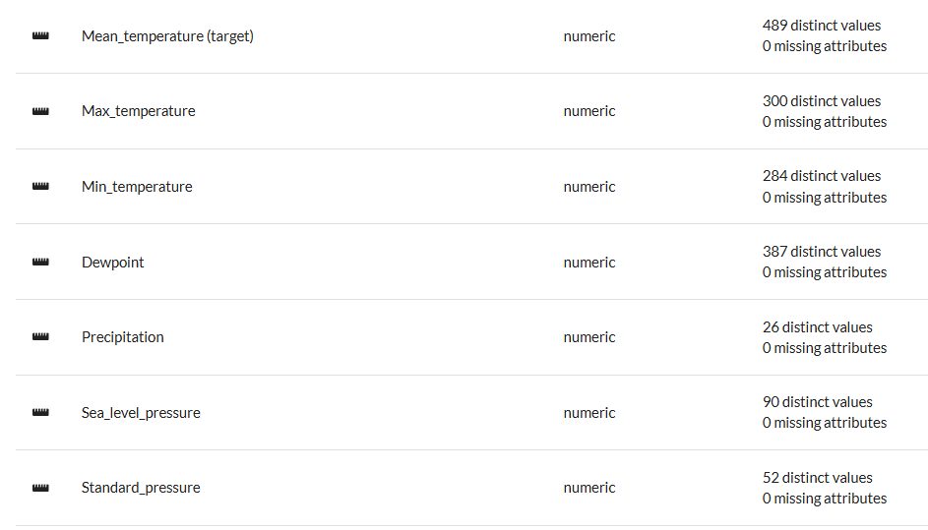
Data 1 information

Slide 5
Model 1
Input Layer:
The model has 9 input nodes, representing the dataset's 10 features, excluding the target variable.
Hidden Layer:
Contains 1 Dense layer with 5 nodes.
Activation function: Sigmoid.
Parameters: 50 (calculated as 9 input features × 5 nodes + 5 biases).
Output Layer:
Contains 1 Dense layer with 1 node.
Designed for regression tasks.
Parameters: 6 (calculated as 5 hidden nodes × 1 output node + 1 bias).

Slide 6
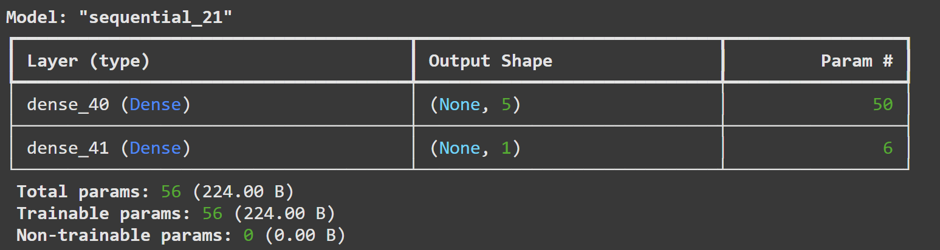
Model 1 summary

Slide 7
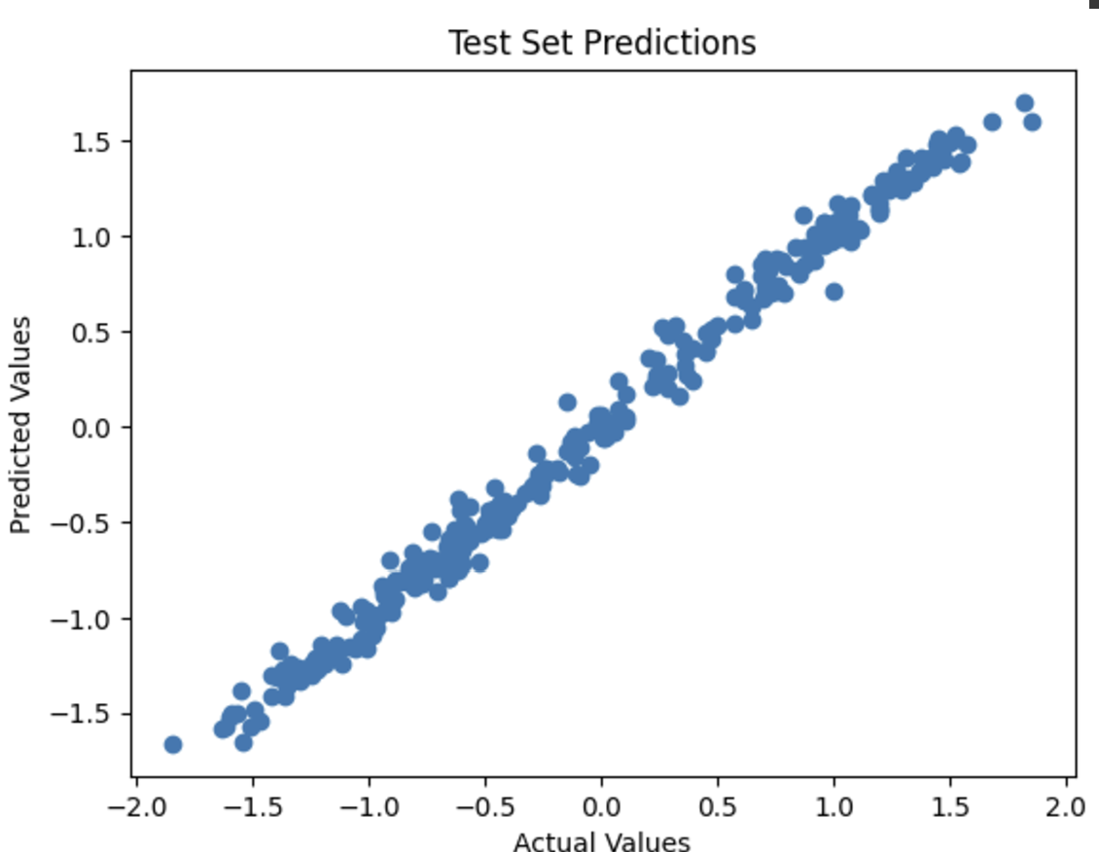
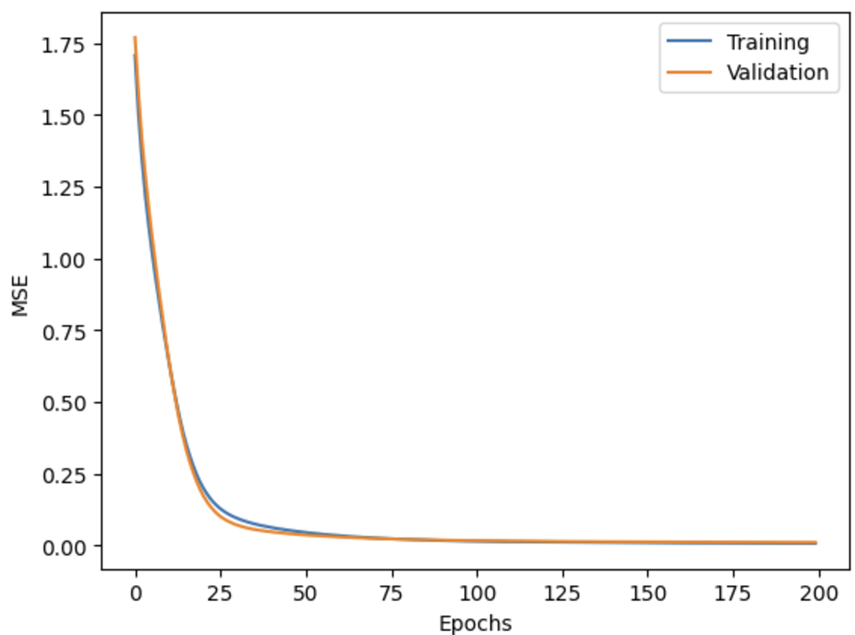
Model 1 Result

Slide 8
Model 2
Input Layer:
The model has 9 input nodes, representing the dataset's 10 features, excluding the target variable.
Hidden Layer:
Contains 1 Dense layer with 30 nodes.
Activation function: Sigmoid.
Parameters: 300 (calculated as 9 input features × 30 nodes + 30 biases).
Output Layer:
Contains 1 Dense layer with 1 node.
Designed for regression tasks.
Parameters: 31 (calculated as 30 hidden nodes × 1 output node + 1 bias).

Slide 9
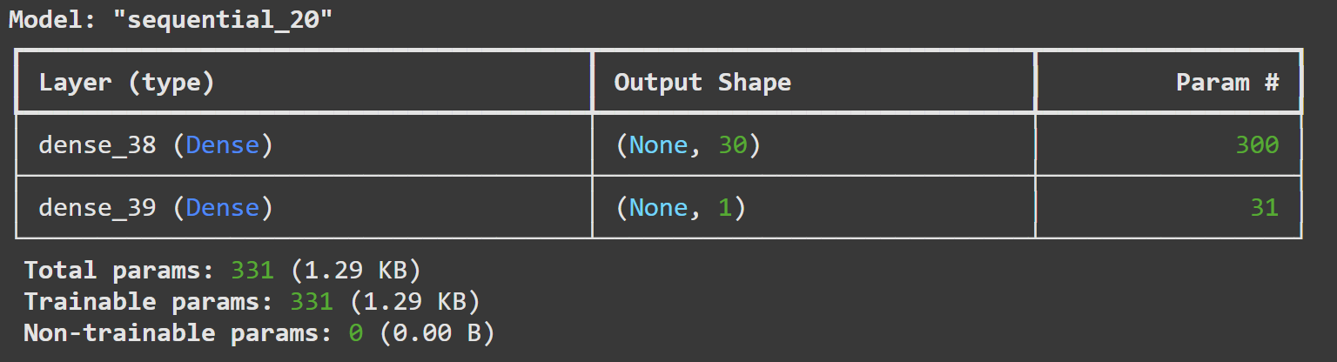
Model 2 summary

Slide 10
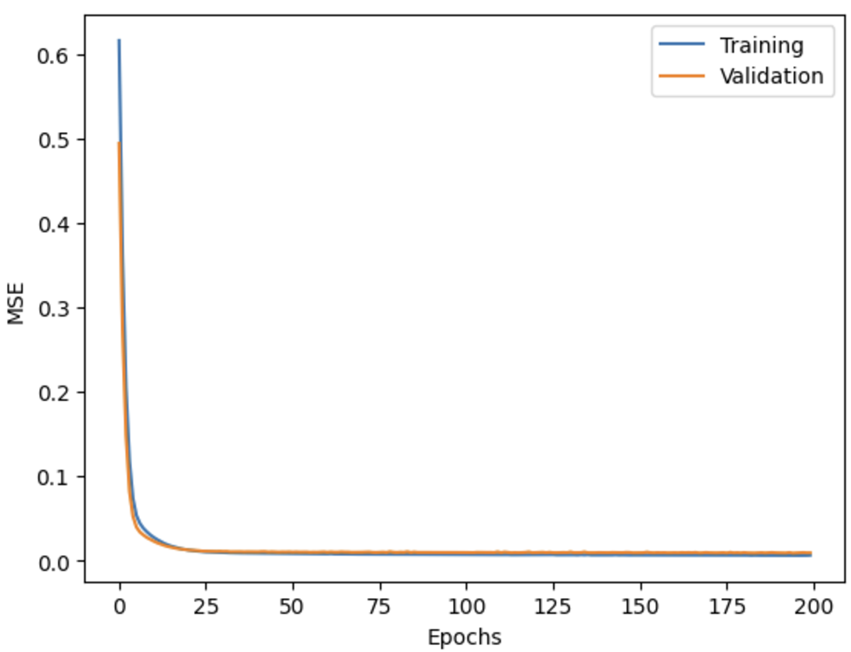
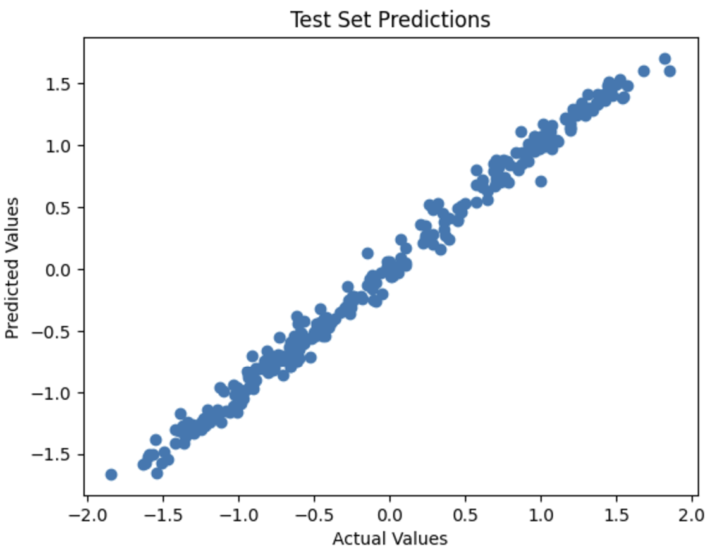
Model 2 Result

Slide 11
Model 3
Input Layer:
The model has 9 input nodes, representing the dataset's 10 features, excluding the target variable.
Hidden Layer:
Contains 1 Dense layer with 200 nodes.
Activation function: Sigmoid.
Parameters: 2,000 (calculated as 9 input features × 200 nodes + 200 biases).
Output Layer:
Contains 1 Dense layer with 1 node.
Designed for regression tasks.
Parameters: 201 (calculated as 200 hidden nodes × 1 output node + 1 bias).

Slide 12
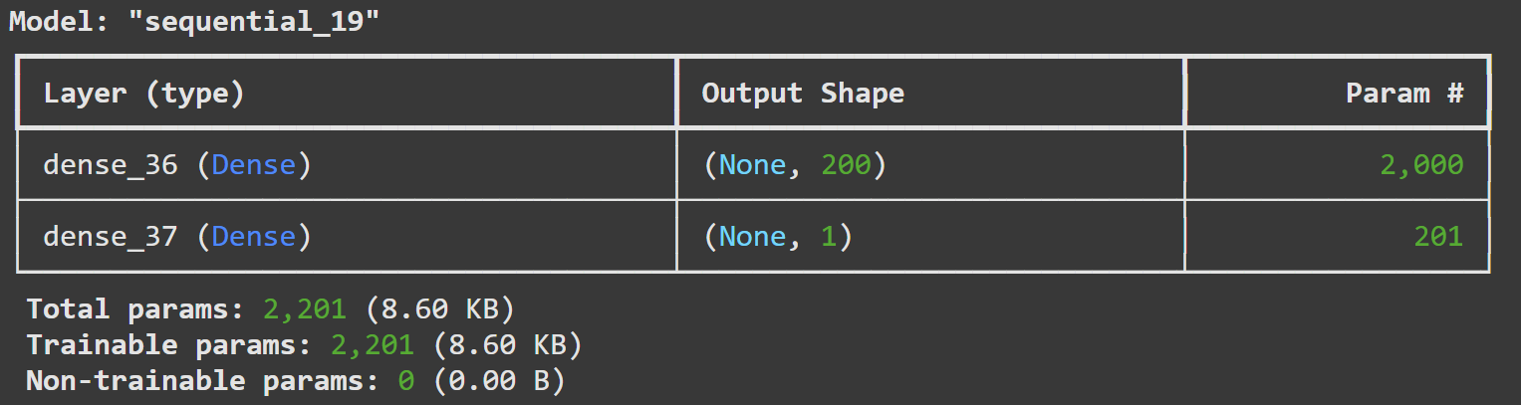
Model 3 summary

Slide 13
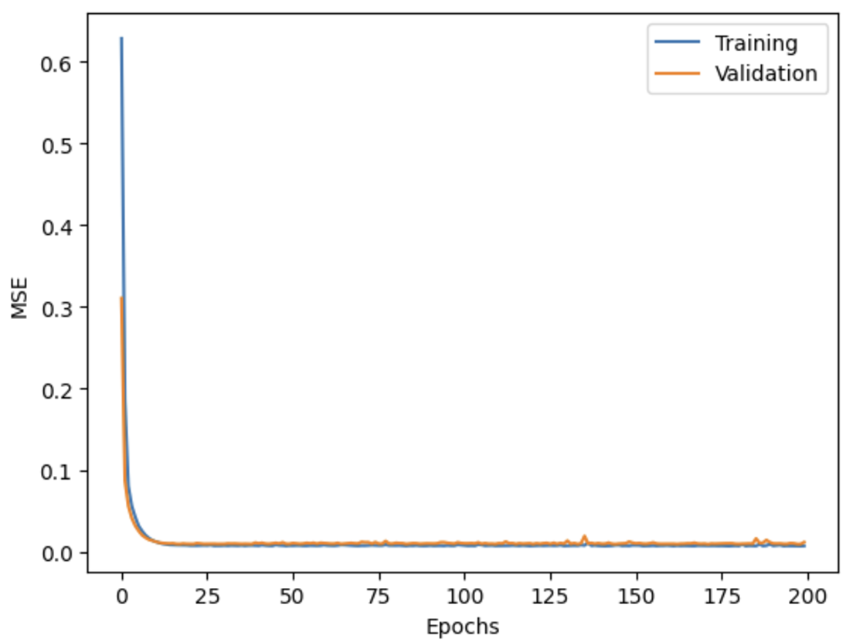
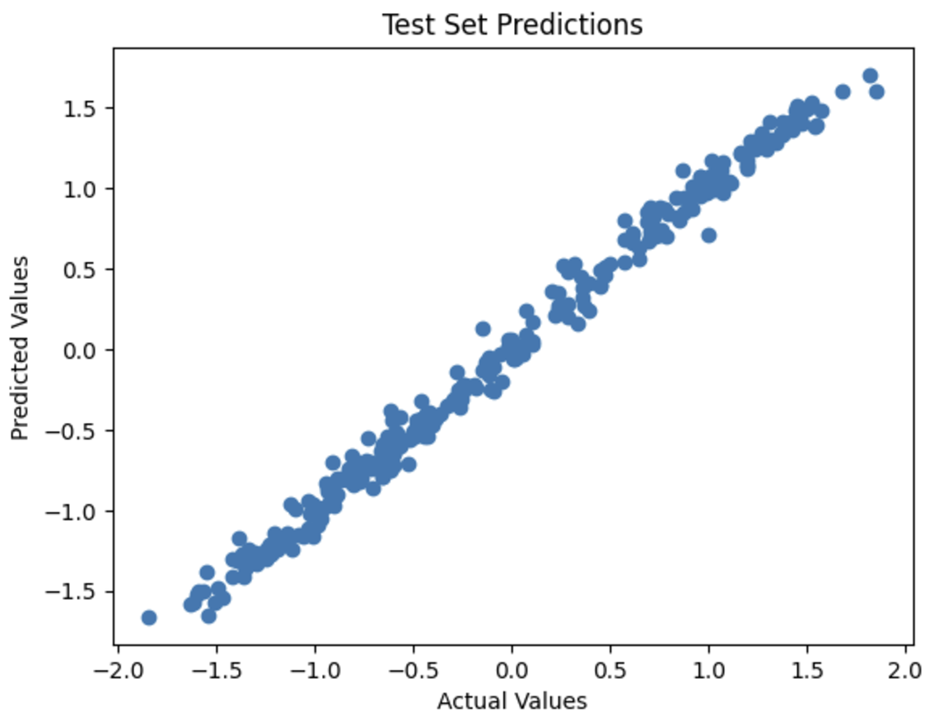
Model 3 Result

Slide 14
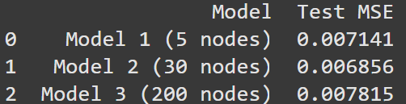
table of test errors

Slide 15
Conclusion
Training and Validation Errors:
All three models show a steady decline in both training and validation MSE across epochs.
The validation error closely follows the training error, indicating that the models are not overfitting.
Comparison of Test MSE:
Model 1 (5 nodes): Test MSE = 0.007141
Model 2 (30 nodes): Test MSE = 0.006856
Model 3 (200 nodes): Test MSE = 0.007815
Model 2 achieves the lowest test error, suggesting that 30 nodes in the hidden layer offer the best balance of model complexity and generalization.
Model Complexity and Performance:
Model 1, with only 5 nodes, may be underfitting the data slightly, as its test error is higher than Model 2.
Model 3, with 200 nodes, shows a slight increase in test error compared to Model 2, potentially due to overfitting, as the model is too complex for the dataset.
Optimal Model:
Model 2 strikes the best balance between complexity and performance, achieving the lowest test MSE.
Adding too many nodes (Model 3) does not improve performance and may increase the risk of overfitting.

Slide 16
Data 2

Slide 17
wind
Data_id = 503
wind daily average wind speeds for 1961-1978 at 12 synoptic meteorological stations in the Republic of Ireland (Haslett and raftery 1989).
There are no nominal features and missing values , both target and features are all numeric , so I didn’t transform the data
https://www.openml.org/search?type=data&sort=runs&status=active&qualities.NumberOfInstances=between_1000_10000&qualities.NumberOfFeatures=between_10_100&qualities.NumberOfClasses=lte_1&id=503

Slide 18
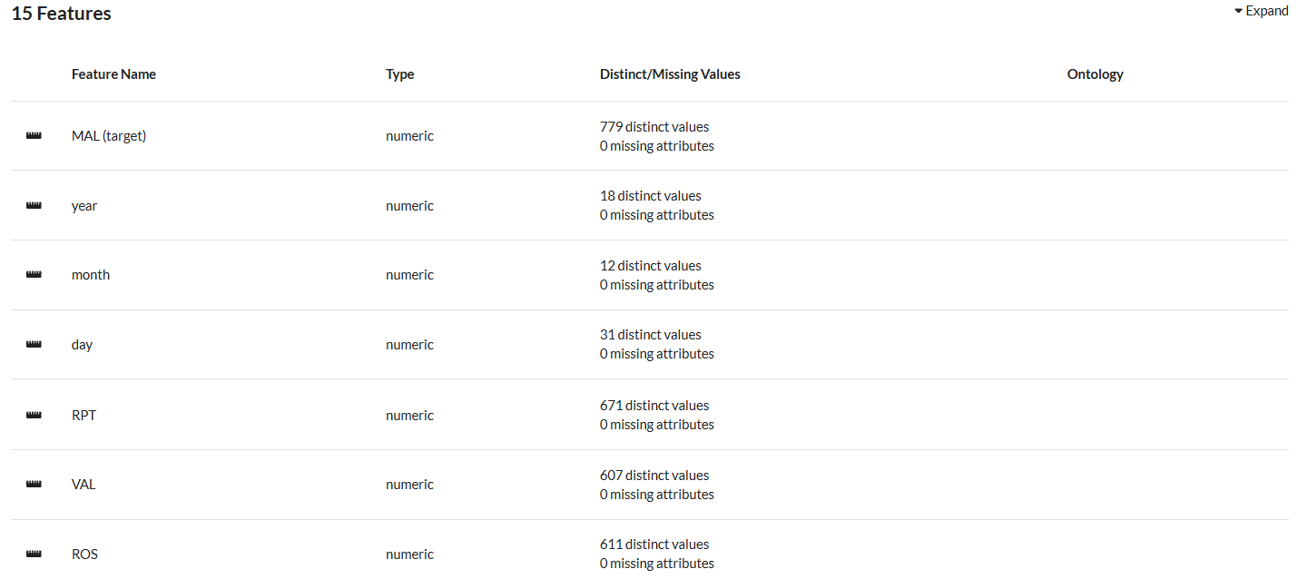
Data 2 information

Slide 19
Model 1
Input Layer:
The model has 14 input nodes, representing the dataset's 15 features, excluding the target variable.
Hidden Layer:
Contains 1 Dense layer with 5 nodes.
Activation function: Sigmoid.
Parameters: 75 (calculated as 14 input features×5 nodes+5 biases14 input features×5 nodes+5 biases).
Output Layer:
Contains 1 Dense layer with 1 node.
Designed for regression tasks.
Parameters: 6 (calculated as 5 hidden nodes×1 output node+1 bias5 hidden nodes×1 output node+1 bias)

Slide 20
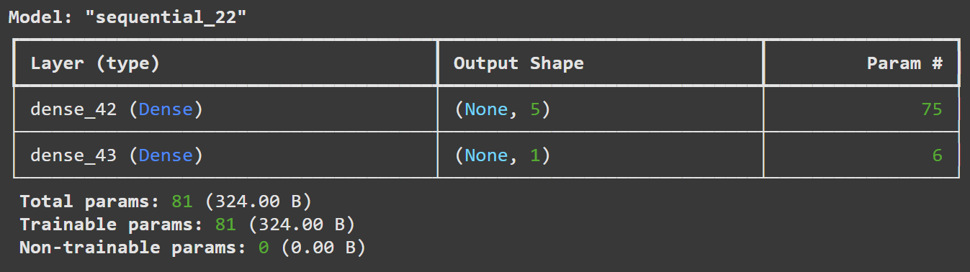
Model 1 summary

Slide 21
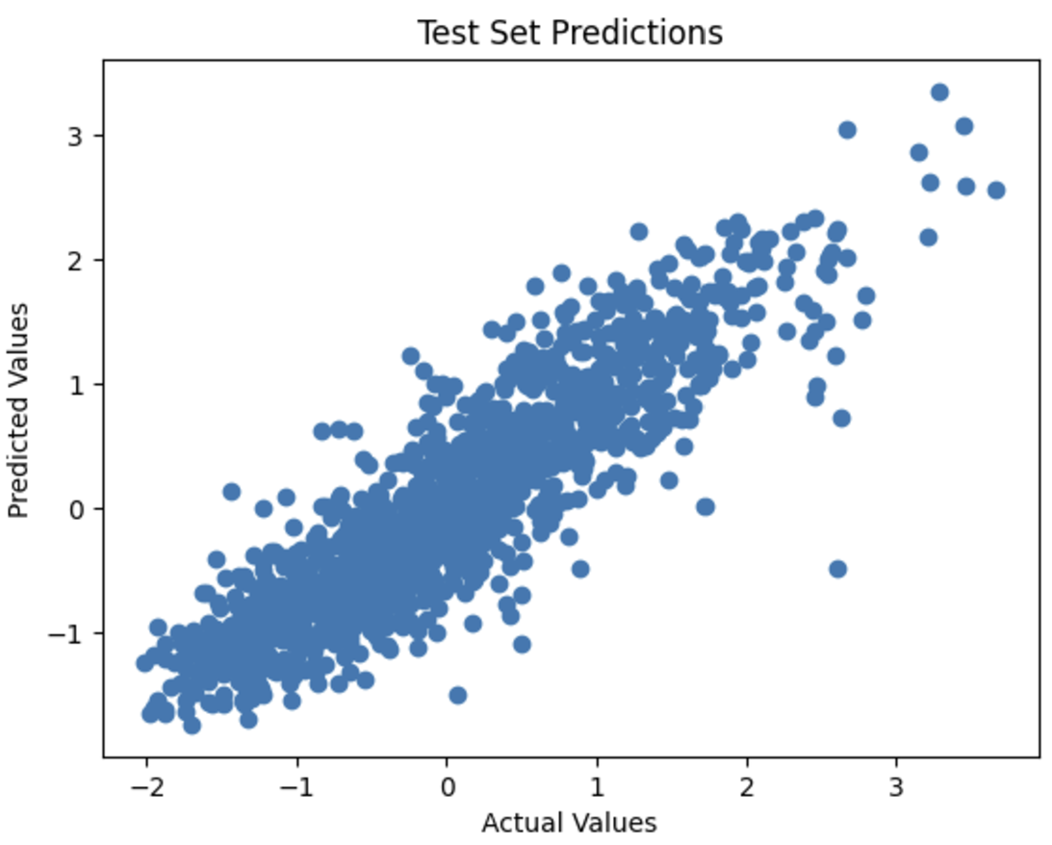
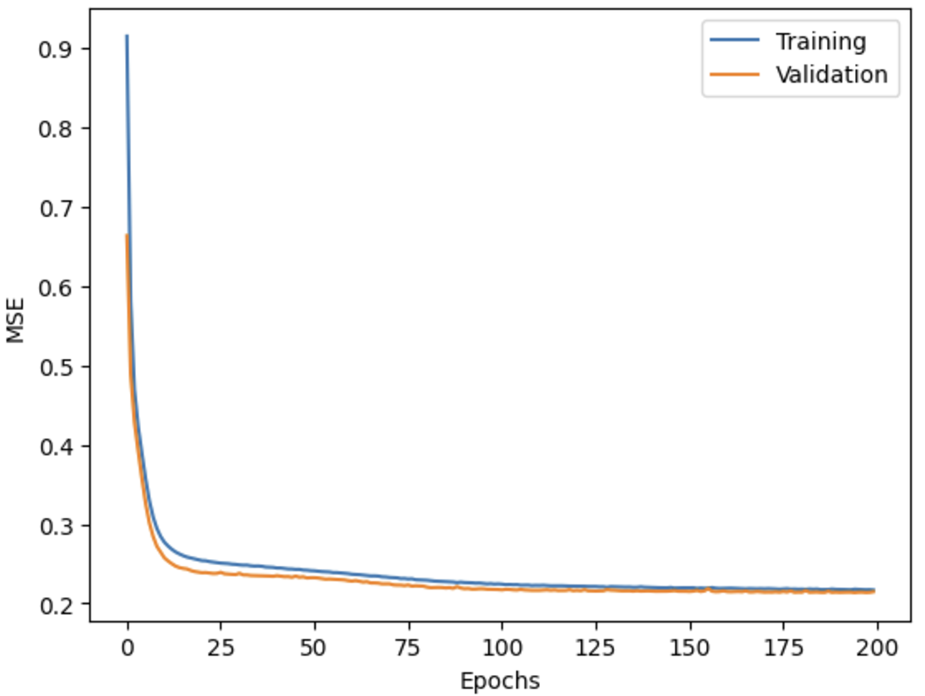
Model 1 Result

Slide 22
Model 2
Input Layer:
The model has 14 input nodes, representing the dataset's 15 features, excluding the target variable.
Hidden Layer:
Contains 1 Dense layer with 30 nodes.
Activation function: Sigmoid.
Parameters: 300 (calculated as 14 input features×30 nodes+30 biases14 input features×30 nodes+30 biases).
Output Layer:
Contains 1 Dense layer with 1 node.
Designed for regression tasks.
Parameters: 31 (calculated as 30 hidden nodes×1 output node+1 bias30 hidden nodes×1 output node+1 bias).

Slide 23
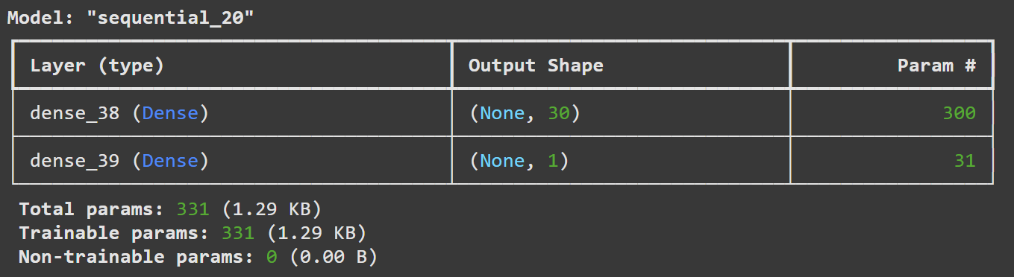
Model 2 summary

Slide 24

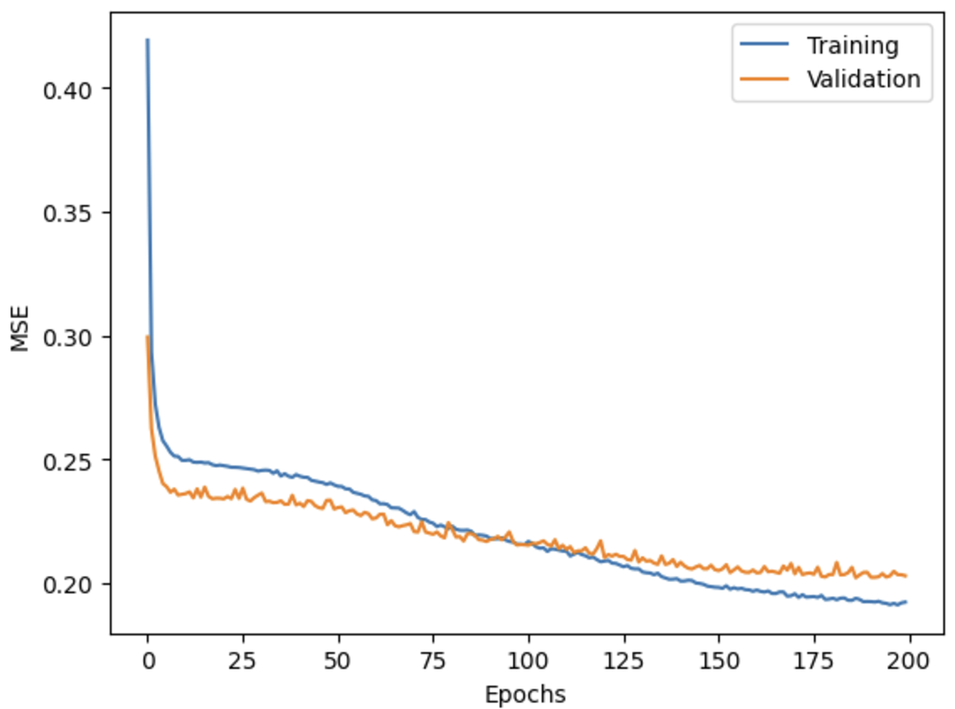
Model 2 Result

Slide 25
Model 3
Input Layer:
The model has 14 input nodes, representing the dataset's 15 features, excluding the target variable.
Hidden Layer:
Contains 1 Dense layer with 200 nodes.
Activation function: Sigmoid.
Parameters: 3,000 (calculated as 14 input features×200 nodes+200 biases14 input features×200 nodes+200 biases).
Output Layer:
Contains 1 Dense layer with 1 node.
Designed for regression tasks.
Parameters: 201 (calculated as 200 hidden nodes×1 output node+1 bias200 hidden nodes×1 output node+1 bias).

Slide 26
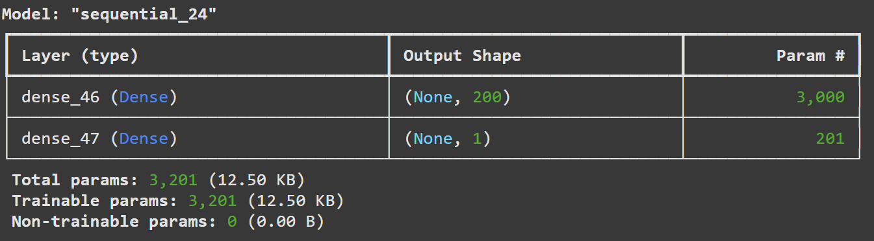
Model 3 summary

Slide 27
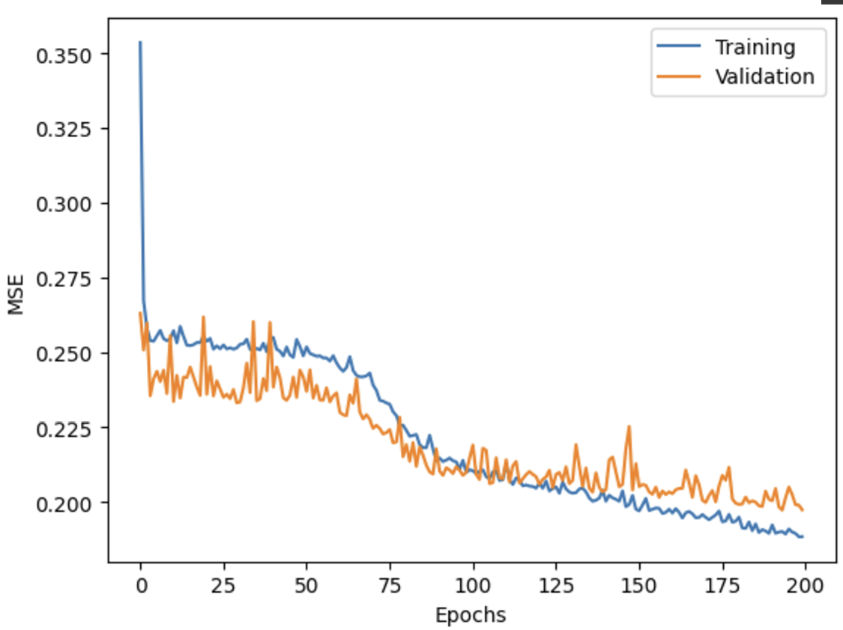

Model 3 Result

Slide 28
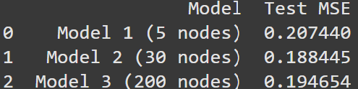
table of test errors

Slide 29
Conclusion
Training and Validation Errors:
All three models show a steady decline in both training and validation MSE across epochs.
The validation error closely follows the training error, indicating that the models are not overfitting.
Comparison of Test MSE:
Model 1 (5 nodes): Test MSE = 0.007141
Model 2 (30 nodes): Test MSE = 0.006856
Model 3 (200 nodes): Test MSE = 0.007815
Model 2 achieves the lowest test error, suggesting that 30 nodes in the hidden layer offer the best balance of model complexity and generalization.
Model Complexity and Performance:
Model 1, with only 5 nodes, may be underfitting the data slightly, as its test error is higher than Model 2.
Model 3, with 200 nodes, shows a slight increase in test error compared to Model 2, potentially due to overfitting, as the model is too complex for the dataset.
Optimal Model:
Model 2 strikes the best balance between complexity and performance, achieving the lowest test MSE.
Adding too many nodes (Model 3) does not improve performance and may increase the risk of overfitting.

